Slide 1

Travel Pack
Prepared for:
Blueprint
Canada
Sep 1st - Sep 9th

Slide 2
Table of Contents
1 | Entry/Exit Requirements
2 | Etiquette and Cultural Expectations
3 | Event Information
4 | Budget
5 | Travel Itinerary

Slide 3
Entry/Exit requirements

Slide 4
Documentation Requirements
ENTRY:
Passport with expiration date more than 6 months from entry date (✔)
US Visa
EXIT:
Return flight ticket and valid visa
Immigration, Refugees and Citizenship Canada (IRCC): https://www.canada.ca/en/immigration-refugees-citizenship.html ¹
Additional Resources:
Travelstart: https://visa.vfsglobal.com/one-pager/nigeria/canada/english/pdf/Nigeria-Tourist-

Slide 5
Etiquette and Cultural Expectations

Slide 6
Etiquette and Cultural Expectations
Greetings and Communication
Introductions: A firm handshake and direct eye contact are common greetings.
Courtesy: Always say "please" and "thank you."
Clear Communication: Be direct and to the point when speaking.
Dining Etiquette
Gratitude: Tip generously for good service.
Table Manners: Use good table manners.
Business Etiquette
Timeliness: Be punctual for meetings and appointments.
Professional Appearance: Dress appropriately for business occasions.
Directness: Communicate clearly and concisely in business settings.
Cultural Sensitivity
Respect for Diversity: Appreciate Canada's multiculturalism.
Avoid Stereotypes: Don't make assumptions about people based on their background.

Slide 7
Event information

Slide 8
Event Information
Date | Time | Event
1 Sep | 23:55 | Depart Nigeria
2 Sep | 09:20 | Arrive Canada
3 Sep | 11:00 | Conference meeting
4 Sep | 15:00 | Check in attraction centres
5 Sep | 12:00 | Travel to the country side
6 Sep | 14:30 | Meeting with Jeremiah ALX
7 Sep | 20:00 | Dance night
8 Sep | 11:00 | Watch a movie
9 Sep | 06:30 | Depart Canada

Slide 9
Budget

Slide 10
Budget
ITEM | COST ($)
Visa Application Process | 150
Flights | 1500
Accomodation | 2000
Activities | 3000
Meals | 2000
Total Cost | 8650

Slide 11
Itinerary

Slide 12
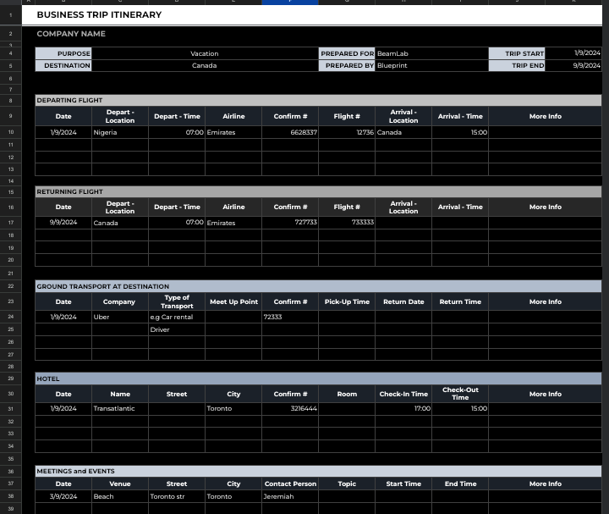
Itinerary (Trip Summary)

Slide 13
Travel schedule
Carrier | Class | Dep.Date | From | To | Dep | Arr | Arr.Date
Travel to Canada - 27 hrs 16 mins
Emirates | First | 1-Sep | Nigeria | Canada | 23:55 | 5:55 | 2-Nov
Click the links below to view tickets:
Canada to Nigeria return Tickets

Slide 14
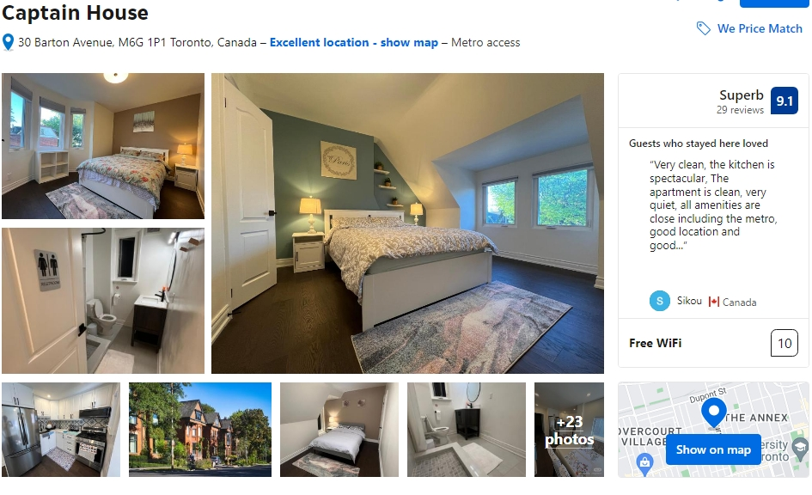
Hotel confirmation

